Slide 1

ELECTROSTATICS
Study of Electric Charges at rest

Slide 2
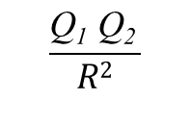
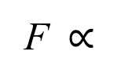
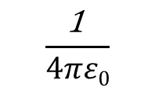
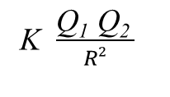
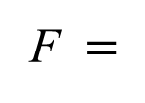
COULOMB’S LAW
Force between two small objects separated in free space by a distance which is large compared to their size is proportional to the charge on each and inversely proportional to square of the distance between them
Magnitude of the Force,
Q₁
Q₂
F $∝$
$$\frac{\text{Q}\text{1} \text{Q}\text{2 }}{R2}$$
R
F $=$
K $\frac{\text{Q}\text{1} \text{Q}\text{2 }}{R2}$
$$\frac{\text{1} }{4πε0}$$
Proportionality constant, K =

Slide 3
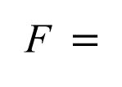
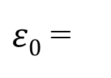
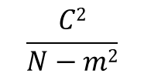
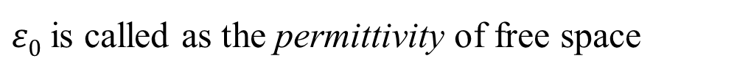
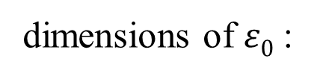
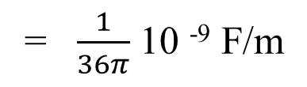
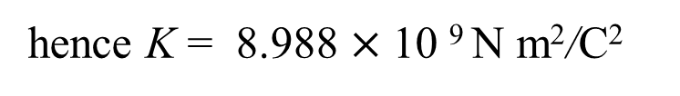
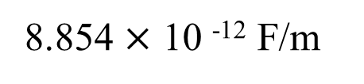
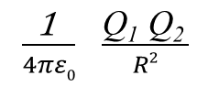
Permittivity
$ε0$ is called as the permittivity of free space
$ε0$ =
8.854 $×$ 10 ⁻¹² F/m
= $\frac{1}{36π}$ 10 ⁻⁹ F/m
dimensions of $ε0$ :
$$\frac{C2}{N−m2}$$
hence K = 8.988 $×$10 ⁹ N m²/C²
Now the magnitude of the force between two charges is
F $=$
$\frac{\text{1} }{4πε0}$ $\frac{\text{Q}\text{1} \text{Q}\text{2 }}{R2}$

Slide 4




Problem :
Find the Number of electrons in one coulomb charge & also find the force between two, one coulomb charges separated by 1m distance in free space
Charge on one electron =
1.6 $×$ 10 ⁻¹⁹ C
No.of electrons in one Coulomb charge =
6.25 $×$ 10 ¹⁸
1C
1C
1m
F = $\frac{\text{1} }{4πε0}$ $\frac{\text{Q}\text{1} \text{Q}\text{2 }}{R2}$
= 9 $×$ 10 ⁹ N
= 1 Million Tons

Slide 5
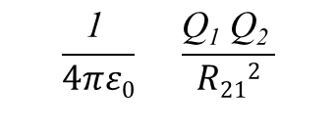
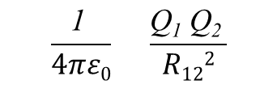

COULOMB’S LAW – Vector form
The direction of the force is along the line joining the two charges, repulsive if the charges are like charges & attractive in case of opposite charges
z
Force on Q₂ is
$$\frac{\text{1} }{4πε0} \frac{\text{Q}\text{1} \text{Q}\text{2 }}{R122}$$
a₁₂
F₁₂ =
Q₁
R₁₂
Force on Q₁ is
Q₂
$$\frac{\text{1} }{4πε0} \frac{\text{Q}\text{1} \text{Q}\text{2 }}{R212}$$
a₂₁
F₂₁ =
y
F₁₂ = - F₂₁
Since
R₁₂ = R₂₁ = $|R12|$
& a₁₂ = - a₂₁
x

Slide 6

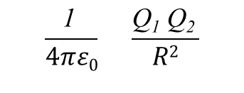





Find the force on a charge of -100mC located at P (2, 0, 5) in free space due to another charge 300µC located at Q (1, 2, 3).
Force on -100$mC$ charge is given by
$$\frac{\text{1} }{4πε0} \frac{\text{Q}\text{1} \text{Q}\text{2 }}{R2}$$
F =
a_{R}
z
Here $\frac{\text{1} }{4πε0}$=
8.988 $×$10 ⁹ N m²/C²
$R$=3
and a_{R}=
(a_{x} - 2y a_{y} + 2 z a_{z})/3
(1, 2, 3)
Q₁
Substituting these values we get
R
300$μC$
-100$mC$
Q₂
F = -10⁴ (a_{x} - 2y a_{y} + 2 z a_{z})
(2, 0, 5)
y
x

Slide 7




A point charge, Q1 = 2µC is at (2, 3, 6) and another charge, Q2 =5 µC is at (0, 0, 0) in free space. Find the force on Q1 due to Q2
Force on $2μC$charge is given by
$$\frac{\text{1} }{4πε0} \frac{\text{Q}\text{1} \text{Q}\text{2 }}{R2}$$
F =
a_{R}
z
Here $\frac{\text{1} }{4πε0}$=
8.988 $×$10 ⁹ N m²/C²
$R$=7
and a_{R}=
(2a_{x} + 3y a_{y} + 6 z a_{z})/7
Substituting these values we get
$$2μC$$
Q₁
F = 0.26 x 10⁻³ (2a_{x} + 3y a_{y} + 6 z a_{z})
R
(2, 3, 6)
(0, 0, 0)
Q₂
y
5$μC$
x

Slide 8

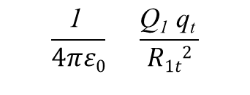
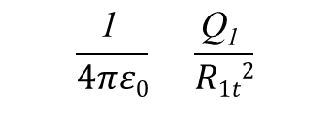

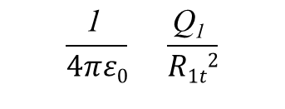
ELECTRIC FIELD INTENSITY, E
Consider a charge Q₁ and a positive test charge q_{t}
F_{t}
Force on q_{t} due to Q₁ is
q_{t}
F_{t} =
$$\frac{\text{1} }{4πε0} \frac{\text{Q}\text{1} \text{q}\text{t} }{R1t2}$$
a_{1t}
Q₁
Now the force per unit positive charge is obtained as
$$\frac{\text{1} }{4πε0} \frac{\text{Q}\text{1} }{R1t2}$$
$\frac{\text{F}\text{t}}{\text{q}\text{t}}$ =
a_{1t}
Force per unit positive charge at a point in space is called as the Electric Field Intensity at that point.
Hence
$$\frac{\text{1} }{4πε0} \frac{\text{Q}\text{1} }{R1t2}$$
E_{t}=
$\frac{\text{F}\text{t}}{\text{q}\text{t}}$ =
a_{1t}

Slide 9


ELECTRIC FIELD INTENSITY – General Expression
Electric Field Intensity E at a point due to a point charge Q can be expressed as
$$\frac{\text{1} }{4πε0} \frac{\text{Q} }{R2}$$
E =
a_{R}
E = ?
$$\frac{R}{|R|}$$
Where R = and a_{R} =
R
|R|
Q

Slide 10
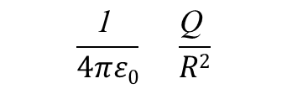
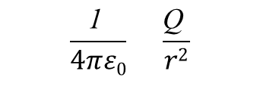

Problem :
Calculate the electric filed intensity E, at a point P(r, $θ$, $φ$), when a point charge Q is located at the origin
Since the electric field intensity is given by
$$\frac{\text{1} }{4πε0} \frac{\text{Q} }{R2}$$
E =
a_{R}
z
Here R =
r a_{r}
hence R =
a_{R} =
a_{r}
P(r, $θ$, $φ$)
r
and
E = ?
R
Now the Electric Field Intensity at P is
Q
y
$$\frac{\text{1} }{4πε0} \frac{\text{Q} }{r2}$$
E _{at P} =
a_{r}
x

Slide 11
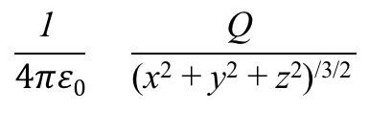
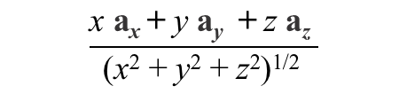

Problem :
Calculate the electric filed intensity E, at a point P(x, $y$, $z$), when a point charge Q is located at the origin
Since the electric field intensity is given by
$$\frac{\text{1} }{4πε0} \frac{\text{Q} }{R2}$$
E =
a_{R}
z
Here R =
x a_{x} + y a_{y} + z a_{z}
P(x, $y$, $z$)
hence R =
(x² + y² + z²)^{1/2}
$$\frac{\text{x} \text{a}\text{x} \text{+ }\text{y} \text{a}\text{y}\text{ + }\text{z} \text{a}\text{z} }{\text{(}\text{x}\text{2}\text{ + }\text{y}\text{2}\text{ + }\text{z}\text{2}\text{)}\text{1/2 }}$$
and
a_{R} =
E = ?
R
Now the Electric Field Intensity at P is
Q
y
$$\frac{\text{1} }{4πε0} \frac{\text{Q} }{\text{(}\text{x}\text{2}\text{ + }\text{y}\text{2}\text{ + }\text{z}\text{2}\text{)}\text{/}\text{3/}\text{2 }}$$
x a_{x} + y a_{y} + z a_{z}
E _{at P} =
x

Slide 12


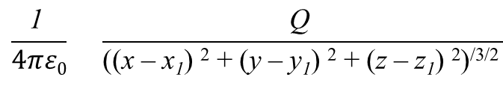

Problem :
Calculate the electric filed intensity E, at a point P(x, $y$, $z$), when a point charge Q is located at P’(x₁, $y1$, $z1$)
Since the electric field intensity is given by
$$\frac{\text{1} }{4πε0} \frac{\text{Q} }{R2}$$
E =
a_{R}
z
Here R =
(x – x₁) a_{x} + (y – y₁) a_{y} + (z – z₁) a_{z}
P(x, $y$, $z$)
hence R =
((x – x₁) ² + (y – y₁) ² + (z – z₁) ²)^{1/2}
E = ?
P’(x₁, $y1$, $z1$)
R
$$\frac{\text{(}\text{x} \text{– }\text{x}\text{1}\text{)} \text{a}\text{x} \text{+ }\text{ (}\text{y} \text{– }\text{y}\text{1}\text{)} \text{a}\text{y}\text{ + }\text{ (}\text{z} \text{– }\text{z}\text{1}\text{)} \text{a}\text{z} }{\text{(}\text{(}\text{x} \text{– }\text{x}\text{1}\text{)} \text{2}\text{ + }\text{(}\text{y} \text{– }\text{y}\text{1}\text{) }\text{2}\text{ + }\text{(}\text{z} \text{– }\text{z}\text{1}\text{)} \text{2}\text{)}\text{1/2 }}$$
and
a_{R} =
Q
y
Now the Electric Field Intensity at P is
E _{at P} =
$$\frac{\text{1} }{4πε0} \frac{\text{Q} }{\text{(}\text{(}\text{x} \text{– }\text{x}\text{1}\text{)} \text{2}\text{ + }\text{(}\text{y} \text{– }\text{y}\text{1}\text{) }\text{2}\text{ + }\text{(}\text{z} \text{– }\text{z}\text{1}\text{)} \text{2}\text{)}\text{/}\text{3/}\text{2 }}$$
$$\text{(}\text{x} \text{– }\text{x}\text{1}\text{)} \text{a}\text{x} \text{+ }\text{ (}\text{y} \text{– }\text{y}\text{1}\text{)} \text{a}\text{y}\text{ + }\text{ (}\text{z} \text{– }\text{z}\text{1}\text{)} \text{a}\text{z}$$
x

Slide 13
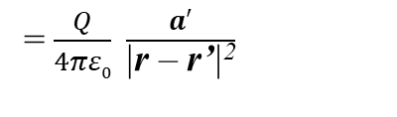

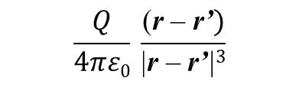


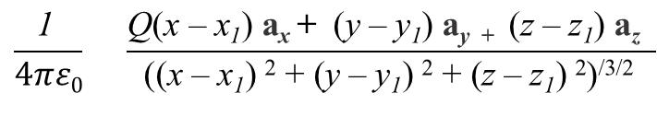

Electric Field Intensity at P can be expressed in terms of position vectors as follows
Now R =
(x – x₁) a_{x} + (y – y₁) a_{y} + (z – z₁) a_{z}
= r – r’
hence R =
((x – x₁) ² + (y – y₁) ² + (z – z₁) ²)^{1/2}
= |r – r’|
z
$$\frac{\text{(}\text{x} \text{– }\text{x}\text{1}\text{)} \text{a}\text{x} \text{+ }\text{ (}\text{y} \text{– }\text{y}\text{1}\text{)} \text{a}\text{y}\text{ + }\text{ (}\text{z} \text{– }\text{z}\text{1}\text{)} \text{a}\text{z} }{\text{(}\text{(}\text{x} \text{– }\text{x}\text{1}\text{)} \text{2}\text{ + }\text{(}\text{y} \text{– }\text{y}\text{1}\text{) }\text{2}\text{ + }\text{(}\text{z} \text{– }\text{z}\text{1}\text{)} \text{2}\text{)}\text{1/2 }}$$
a_{R} =
= $\frac{\text{r}\text{ – }\text{r}\text{’}}{\text{|}\text{r}\text{ – }\text{r}\text{’}\text{|}}$
and
P(x, $y$, $z$)
Now the Electric Field Intensity at P is
P’(x₁, $y1$, $z1$)
R
E _{at P} =
$$\frac{\text{1} }{4πε0} \frac{\text{Q}\text{(}\text{x} \text{– }\text{x}\text{1}\text{)} \text{a}\text{x} \text{+ }\text{ (}\text{y} \text{– }\text{y}\text{1}\text{)} \text{a}\text{y}\text{ + }\text{ (}\text{z} \text{– }\text{z}\text{1}\text{)} \text{a}\text{z} }{\text{(}\text{(}\text{x} \text{– }\text{x}\text{1}\text{)} \text{2}\text{ + }\text{(}\text{y} \text{– }\text{y}\text{1}\text{) }\text{2}\text{ + }\text{(}\text{z} \text{– }\text{z}\text{1}\text{)} \text{2}\text{)}\text{/}\text{3/}\text{2 }}$$
Q
OP = r
OP’ = r’
y
E _{at P} =
$$\frac{Q}{4πε0} \frac{\text{(}\text{r}\text{ – }\text{r}\text{’})}{\text{|}\text{r}\text{ – }\text{r}\text{’}\text{|}3}$$
= $\frac{Q}{4πε0} \frac{a′}{\text{|}\text{r}\text{ – }\text{r}\text{’}\text{|}\text{2}}$
$\frac{\text{r}\text{ – }\text{r}\text{’}}{\text{|}\text{r}\text{ – }\text{r}\text{’}\text{|}}$
E(r) =
where
$a′$ =
x

Slide 15

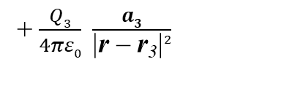
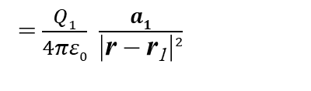

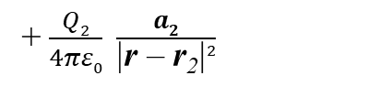
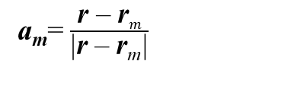
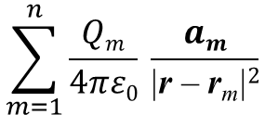



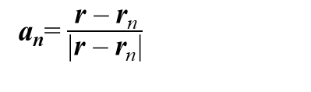




Field due to No.of Point Charges
Let Q₁, Q₂, Q₃ … be the point charges located at the points given by the position vectors r₁, r₂, r₃ …
Now the total Electric field intensity at the point with position vector r
z
= Sum of the individual field intensities at r due to each charge
Q5
i.e
$$\text{r}\text{5}$$
Q2
E(r) =
E_{Q1}+ E_{Q2} + E_{Q3} + E_{Q4} + ….
$$\text{r}\text{2}$$
Q3
$$\text{r}\text{3}$$
r
= $\frac{Q1}{4πε0} \frac{a1}{\text{|}\text{r}\text{ – }\text{r}\text{1}\text{|}2}$
+ $\frac{Q2}{4πε0} \frac{a2}{\text{|}\text{r}\text{ – }\text{r}\text{2}\text{|}2}$
+ $\frac{Q3}{4πε0} \frac{a3}{\text{|}\text{r}\text{ – }\text{r}\text{3}\text{|}2}$
+ $−−−$
Q1
Q6
$$\text{r}\text{1}$$
$$\text{r}\text{6}$$
a_{n}= $\frac{\text{r}\text{ – }\text{r}\text{n}}{\text{|}\text{r}\text{ – }\text{r}\text{n}\text{|}}$
Q8
Where
Q7
$$\text{r}\text{7}$$
y
$$\text{r}\text{8}$$
(or)
Q4
$$\text{r}\text{4}$$
$$\sum_{m=1}^{n}{\frac{Qm}{4πε0} \frac{am}{\text{|}\text{r}\text{ – }\text{r}\text{m}\text{|}2}}$$
a_{m}= $\frac{\text{r}\text{ – }\text{r}m}{\text{|}\text{r}\text{ – }\text{r}\text{m}\text{|}}$
E(r) =
Where
x

Slide 16
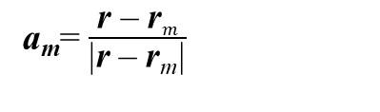
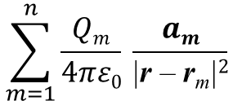
Problem :
Point charges 1mC and -2mC are located at (3, 2, -1) and (-1, -1, 4) respectively. Calculate the electric force on 10nC charge located at (0,3,1) and the electric field intensity at that point.
$$\sum_{m=1}^{n}{\frac{Qm}{4πε0} \frac{am}{\text{|}\text{r}\text{ – }\text{r}\text{m}\text{|}2}}$$
a_{m}= $\frac{\text{r}\text{ – }\text{r}m}{\text{|}\text{r}\text{ – }\text{r}\text{m}\text{|}}$
Ans :
E(r) =
Where
E(r) = − 651.2 a_{x}​−371.3 a_{y}​+ 750.9a_{z}​ kV/m
Now force on 10nC charge located at (0,3,1) is, F = E.Q
F = − 6.512a_{x}​ − 3.713 a_{y}​ + 7.509a_{z} ​ mN

Slide 17
Practice Session
Problem :
A point charge, Q1 = 2µC is at (2, 3, 6) and another charge, Q2 =5 µC is at (0, 0, 0) in free space. Find the force on Q1 due to Q2
Problem :
Find the force on a charge of -100mC located at P (2, 0, 5) in free space due to another charge 300µC located at Q (1, 2, 3).

Slide 18
CONTINUOUS CHARGE DISTRIBUTIONS
Charges on surfaces usually located very close and can be assumed as Continuous distribution of Charges
In a system of Closely Spaced charges , Charge could be continuously distributed
1. along a Line
2. over a Surface
3. through out a volume

Slide 19



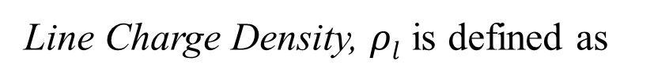














CONTINUOUS CHARGE DISTRIBUTIONS_{Contd.}
Line Charge
When the charge is distributed in the form of line, it’s called Line Charge Distribution.
It’s represented by Line Charge Density, $ρl$
$$ρl$$
$$+$$
Line Charge Density, $ρl$ is defined as
$$+$$
$$+$$
$$ρl$$
=
$$\lim_{∆L→0}{\frac{∆Q}{∆L}}$$
=
$$\frac{dQ}{dL}$$
C/m
$$∆Q$$
$$∆L$$
$$+$$
$$ρl$$
$$+$$
$$dQ$$
=
$$dL$$
$$+$$
$$+$$
Total Charge on the line , Q =
$$\int_{line}{ρl dL }$$

Slide 20

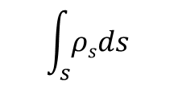
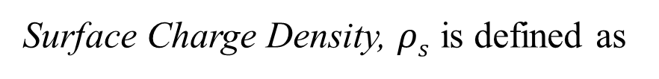







CONTINUOUS CHARGE DISTRIBUTIONS_{Contd.}
Surface Charge
When the charge is distributed over a surface, it’s called Surface Charge Distribution.
It’s represented by Surface Charge Density, $ρs$
Surface Charge Density, $ρs$ is defined as
$$ρs$$
$$∆Q$$
+
$$∆s$$
$$ρs$$
=
$$\lim_{∆s→0}{\frac{∆Q}{∆s}}$$
=
$$\frac{dQ}{ds}$$
C/m²
+
+
+
+
$$ρs$$
$$ds$$
+
$$dQ$$
=
+
+
+
Total Charge on the Surface , Q =
$$\int_{s}{ρsds }$$

Slide 21

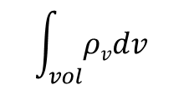








CONTINUOUS CHARGE DISTRIBUTIONS_{Contd.}
Volume Charge
When the charge is distributed in a volume, it’s called Volume Charge Distribution.
It’s represented by Volume Charge Density, $ρv$
Volume Charge Density, $ρs$ is defined as
$$ρv$$
$$\lim_{∆v→0}{\frac{∆Q}{∆v}}$$
$$\frac{dQ}{dv}$$
$$ρv$$
+
$$∆Q$$
=
=
C/m³
+
+
+
$$∆v$$
+
$$ρv$$
$$dv$$
+
+
$$dQ$$
=
Total Charge in the Volume, Q =
$$\int_{vol}{ρvdv }$$

